Slide 1
Cell Disruption / Breakage for Protein Release
Extraction techniques are selected based on the source of protein (e.g. bacteria, plant, mammalian, intracellular or extra cellular)
Use procedures that are as gentle as possible. Cell disruption leads to the release of proteolytic enzymes and general acidification
Selection of an extraction technique often depends on the equipment availability and the scale of operation
Extractions should be performed quickly, at sub-ambient temperatures in a suitable buffer to maintain pH and ionic strength
Samples should be clear and free of particles before beginning chromatography

Slide 2
Cell Disruption: Source Variations
Tissues – variable
Mammalian cells – easy
Plant cells – some problems
Microbial cells – vary, common
Yeast and fungal cells – more difficult

Slide 3
Lyse Cells
Physical
  French pressure cell
  Sonication
  Glass beads
Chemical
  Detergents
  Enzymes
  Hypotonic buffer

Slide 4
Stabilize Sample
Control pH
  Use appropriate buffer
Control temperature
  Keep samples on ice or work in cold room
  Prechill instruments
Prevent frothing/foaming
  Handle gently.
Maintain concentrated sample

Slide 5

Stabilize Sample
Protease inhibitors
  Phenylmethylsulfonyl fluoride (PMSF)
  Leupeptin
  Aprotinin
  Chymostatin
  Pepstatin A

Slide 6
Classification of Proteins by Structural Characterisation
Structural characteristics | Examples | Comments
Monomeric | Lysozyme, growth hormone | Usually extracellular; often have disulphide bonds
Oligomeric with identical subunits | Glyceralsehyde-3-phosphate dehydrogenas, catalase, hexokinase | Mostly intracellular enzymes, rarely have disulphide bonds
Oligomeric with mixed subunits | Petussis toxin | Allosteric enzymes, different subunits have different functions
Membrane bound – peripheral | Mitrochondrial ATPase, alkaline phosphatise | Readily solubilised in detergents
Membrane bound – intergral | Porins, insulin receptors | Requires lipid for stability
Membrane bound – conjugated | Glycoproteins, lipoproteins, nucleoproteins | Many extracellular proteins contain carbohydrate

Slide 7
Classification of Proteins by Function
Function | Examples
Amino acid storage | Seed proteins (e.g. gluten), milk proteins (e.g. caesin)
Structural – inert | Collagen, keratin
Structural – with activity | Actin, myosin, tubulin
Binding – soluble | Albumin, hemoglobin, hormones
Binding – insoluble | Surface receptors (e.g. insulin receptor), antigens (e.g. viral coat proteins)
Binding – with activity | Enzymes, membrane transporters (e.g. ion pumps
Relative abundance

Slide 8
Protein Properties and Their Effect on Development of Purification Strategies
Sample and target protein properties | Influence on purification strategy
Temperature stability | Need to work rapidly at lower temperatures
pH stability | Selection of buffers for extraction and purification (conditions for ion exchange, affinity or reverse phase chromatography)
Organic solvents | Selection of condition for reverse phase chromatography
Detergent requirements | Consider effects on chromatographic steps and the need for detergent removal. consider choice of detergent
Salt (ionic strength) | Selection of conditions for precipitation techniques and hydrophobic interaction chromatography
Co-factors for stability or activity | Selection of additives, pH, salts and buffers
Protease sensitivity | Need for fast removal of proteases or addition of inhibitors
Sensitivity to metal ions | Need to add EDTA or EGTA in buffers
Redox sensitivity | Need to add reducing agents
Molecular weight | Selection of gel filtration media
Charge properties | Selection of ion exchange conditions
Biospecific affinity | Selection of ligand for affinity medium
Post translational modifications | Selection of group specific affinity medium
Hydrophobicity | Selection of medium for hydrophobic interaction chromatography

Slide 9
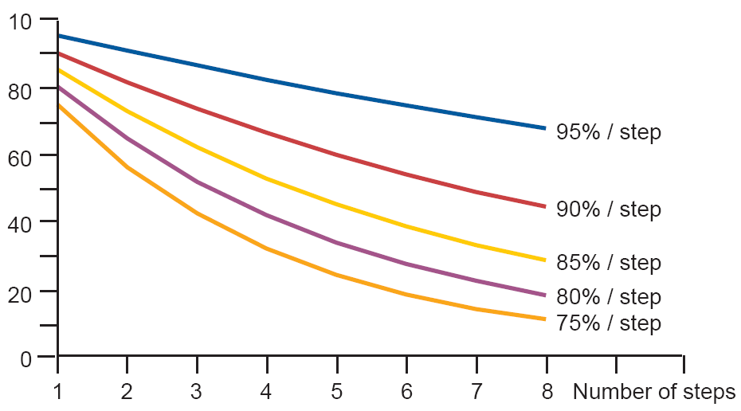
Yields for Multistep Protein Purifications
100
Limit the number of steps
Optimise each step
Be careful of the yield if the proceduce requires several steps

Slide 10
Key Steps in Purification
Release of target protein from starting material
Removal of solids to leave the protein in the supernatant
Concentration of the protein
Removal of contaminants to achieve the desired purity
Stabilization of the target protein

Slide 11
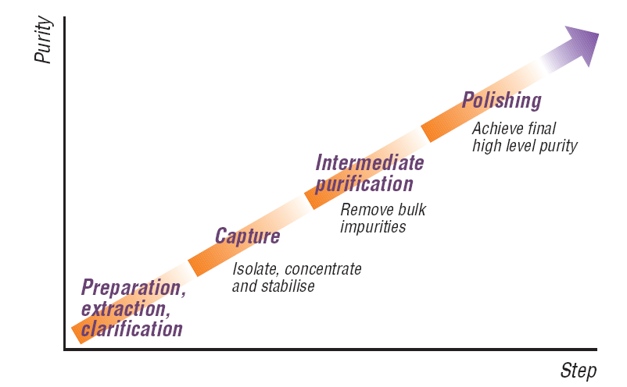
Three Phase Purification Strategy
The final purification process should ideally consist of sample preparation, including extraction and clarification when required, followed by 3 major purifications step. The number of steps will depend on the purification strategy, purity requirements and intended use of the protein

Slide 12
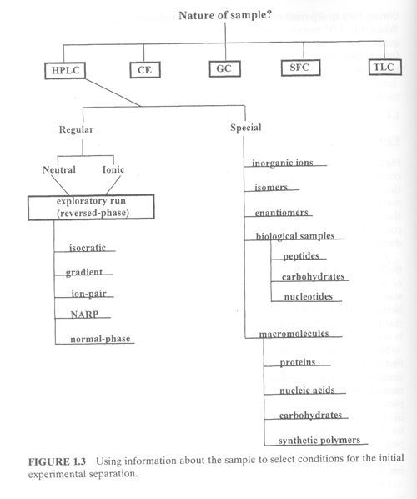
Overall Strategy
First select an appropriate method
If LC is best, then determine nature of the sample
“Exploratory” RP runs, i.e. fast simple gradients with C18 phases, are usually helpful in assessing retention and polarity

Slide 13
Protein Solubility
Salting in
  Ions shield charges and allow proteins to fold.
Salting out
  Ions compete with water to interact with side groups. When [salt] is high enough, salt wins causing protein to precipitate.
  Generally use ammonium sulfate to precipitate proteins in the lab.
solubility
“salting in”
“salting out”
[salt]

Slide 14
Ammonium Sulfate Precipitation
Has a wide range of application
Relies on fact that proteins loose solubility as concentration of salt is increased
  Is characteristic of particular protein
  Results in a partial purification of all proteins with similar solubility characteristics
  Must determine [(NH₄)₂SO₄] to precipitate your protein empirically.
Produces “salt cuts”

Slide 15
Salting in / Salting out
Salting IN
At low concentrations, added salt usually increases the solubility of charged macromolecules because the salt screens out charge-charge interactions.
So low [salt] prevents aggregation and therefore precipitation or “crashing.”
Salting OUT
At high concentrations added salt lowers the solubility of macromolecules because it competes for the solvent (H₂O) needed to solvate the macromolecules.
So high [salt] removes the solvation sphere from the protein molecules and they come out of solution.

Slide 16
Salting Out
The first step in purifying a protein is establishing a “crude extract.” This requires that the membrane of the cell be ruptured by some technique.
Upon rupturing the membrane and releasing the contents of the cell, the insoluble debris is removed by centrifugation.
Typically, one of the initial steps involves purifying proteins based on their solubilties in varying concentrations of ammonium sulfate. The solubility of a protein is sensitive to the concentrations of dissolved salts. The solubility of a protein at low ionic strength generally increases with the salt concentration (salting in). At high ionic strength, the solubilities of proteins decreases (salting out).
Many unwanted proteins can be eliminated by adjusting the salt concentration in a solution containing the crude extract to just below the precipitation point of the protein to be purified. In this case the protein to be purified remains in solution, while many others are precipitated. Likewise, unwanted proteins can be eliminated by adjusting the salt concentration to just over the precipitation point of the protein of interest. In this case, the protein of interest will be precipitated while many others will remain in solution.

Slide 17
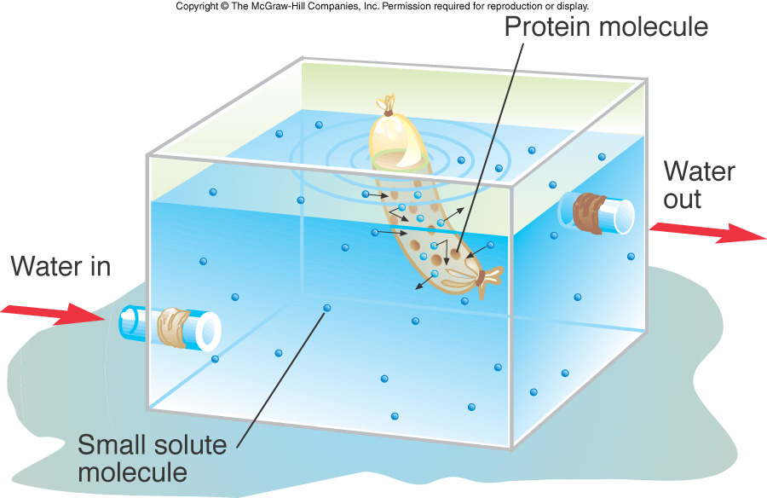
Dialysis
A form of size exclusion chromatography.
Used to desalt and concentrate protein samples.
Dialysis tubing has set molecular weight cut off. Only molecules or ions smaller than MWCO will move out of the dialysis bag.

Slide 18
Dialysis
Passage of solutes through a semi-permeable membrane.
Pores in the dialysis membrane are of a certain size.
Protein stays in; water, salts, protein fragments, and other molecules smaller than the pore size pass through.

Slide 19
Separating Proteins
Chromatography
  Mobile phase
    Phase that carries sample throughout procedure.
      Liquid
      Gas
  Stationary phase
    Matrix that retards the movement of sample being carried by the mobile phase.

Slide 20
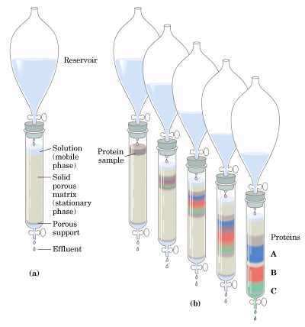
Protein Purification
Before any particular protein can be sequenced and characterized, its is necessary to separate it from all of the other proteins in the cell.
This “purification” process involves separating proteins based on their ionic properties, their sizes, their hydrophobicity, and their affinities for certain molecules (ligands). Each successive step is referred to as fractionation.
Typically some form of column chromatography is employed, in which the solid phase (stationary phase) contains molecules that in some way exploit the differences among various proteins.

Slide 21

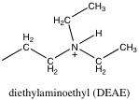
Ion Exchange Chromatography
Separates molecules based on charge.
Mobile phase
  Generally liquid
Stationary phase
  Electrostatically charged ions bound to insoluble, chemically inert martrix.
Elution of protein
  Add salt to compete with binding of sample to stationary phase.
  Change pH (alters charge of protein).
cellulose
(Cation exchange)
cellulose
(Anion exchange)

Slide 22
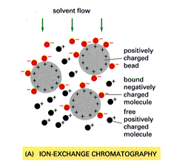
Ion Exchange

Slide 23
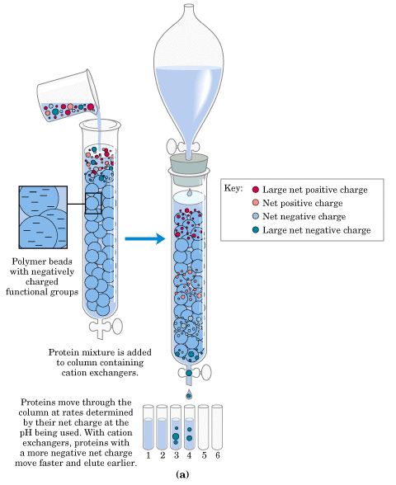
Ion-Exchange Chromatography
The picture at the left represents ion-exchange chromatography on a cation exchanger. Notice that the bead is negatively charged, and therefore the rate of mobility of proteins loaded onto the resin is proportional to the degree of negative charge that they bear.

Slide 24
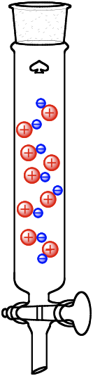
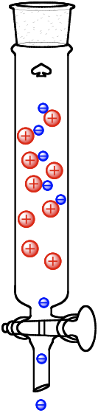
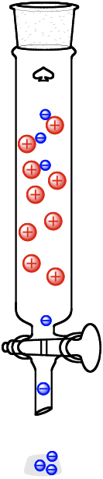
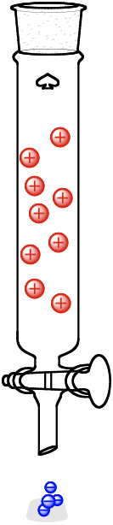
Ion Exchange Chromatography
Low salt
High salt

Slide 25
Examples
Name | Ionizable group | Type
DEAE-Sephadex | Diethylaminoethyl | Weakly basic
SP-Sepharose | Methylsulfonate | Strongly acidic
Bio-Rex 70 | Carboxylic acid | Weakly acidic
P cellulose | Phosphate | Strongly & weakly acidic

Slide 26
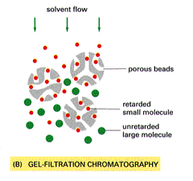
Gel Filtration

Slide 27
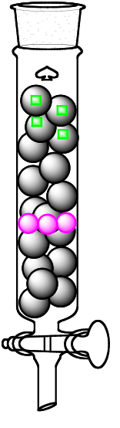
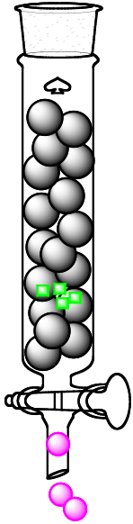
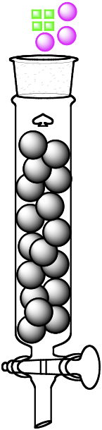
Size Exclusion Chromatography
Separates molecules based on size.
Large molecules exit first.
Mobile phase
  Liquid
Stationary phase
  Insoluble, porous carbohydrate beads

Slide 28
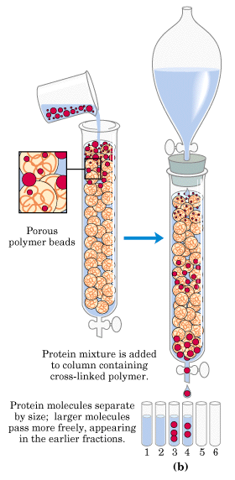
Size Exclusion Chromatography
In size-exclusion chromatography (gel-filtration chromatography), proteins migrate as a function of their molecular weights.
The solid matrix (beads) contains pores of various sizes. The probability of entering the pores of the matrix is inversely proportional to the size of the protein. In fact proteins that are larger than a given size (depending on the resin that is used) are totally excluded from entering the beads. Therefore, larger proteins have a more direct route to the bottom of the column, by simply going around all of the beads rather than entering the beads.
Notice in the figure at left that the large molecules elute first.
Size-exclusion chromatography can be used to determine the molecular weight of a particular protein if appropriate standards are available. As we’ll see in a couple of slides, the elution volume is inversely proportional to the log of the molecular weight.

Slide 29
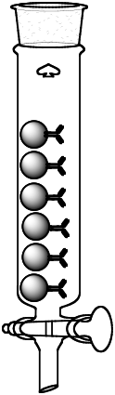
Affinity Chromatography
Mobile phase
  Usually liquid
Stationary phase
  Receptor bound to inert bead
Immunoaffinity column

Slide 30
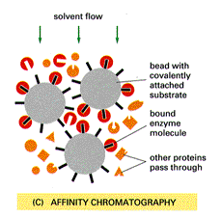
Affinity Chromatography
We will use bound adenosine
-5’-monophosphate. This is
part of NAD⁺. LDH will
bind. Release LDH by adding
NADH

Slide 31
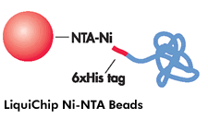

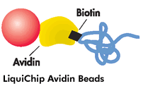
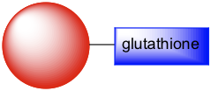
Affinity Chromatography
GST tag

Slide 32
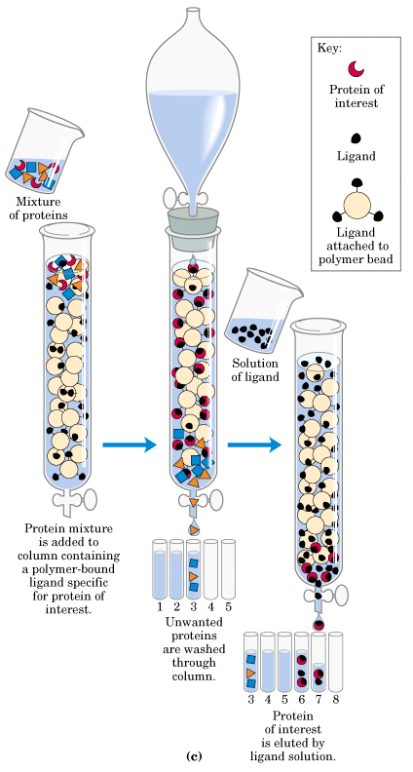
Affinity Chromatography
In affinity chromatography, proteins are separated according to their ability to bind to a specific ligand that is connected to the beads of the resin.
After the proteins that do not bind the ligand are washed through the column, the bound protein of interest is eluted by a solution containing free ligand.

Slide 33
Experimental Procedure
After centrifugation and filtration, the supernatant is measured, and 3 mL is stored as Fraction 1 (F1).
The remaining protein solution is poured back to the centrifugation tube, and picric acid in 0.35 times volume of protein is added under cooling, and centrifuged.
Supernatant is measured, and the bottle is washed. Then 3 mL of supernatant is stored as F2, the remaining solution is poured back to the centrifugation bottle, and 2.5 times volume of cooled acetone is added.
After centrifugation, the supernatant is discarded, and 1 mL of EDTA solution is added to transfer the viscous material to dialysis bag, and kept cold for next week.

